Slide 1
Planner Technical Session In Banff, Places for Cars, Places for People: The Technical Aspects of Joy in Community Spaces
Darren Enns, Director, Planning and Development
Friday, October 14 2022

Slide 2
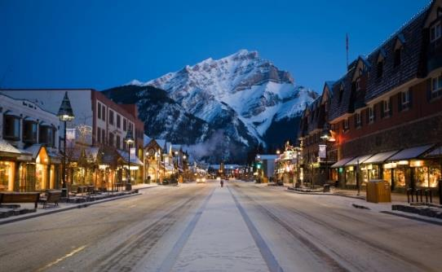
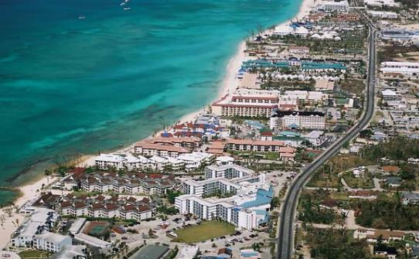
Darren Enns, MCIP
Director, Planning and Development, Town of Banff
Land use planner in tourism-based communities in Canada, US, and Caribbean
National Park planning consultant (UN-Habitat Kosovo)
Councillor, Kananaskis Improvement District

Slide 3
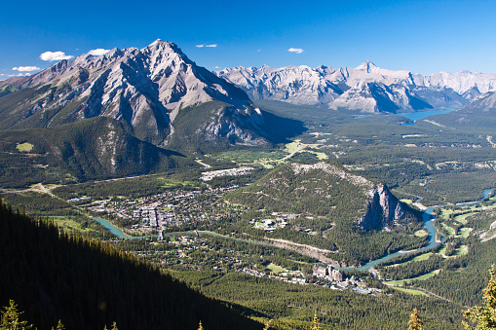

Slide 4
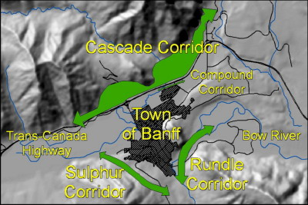

Slide 5
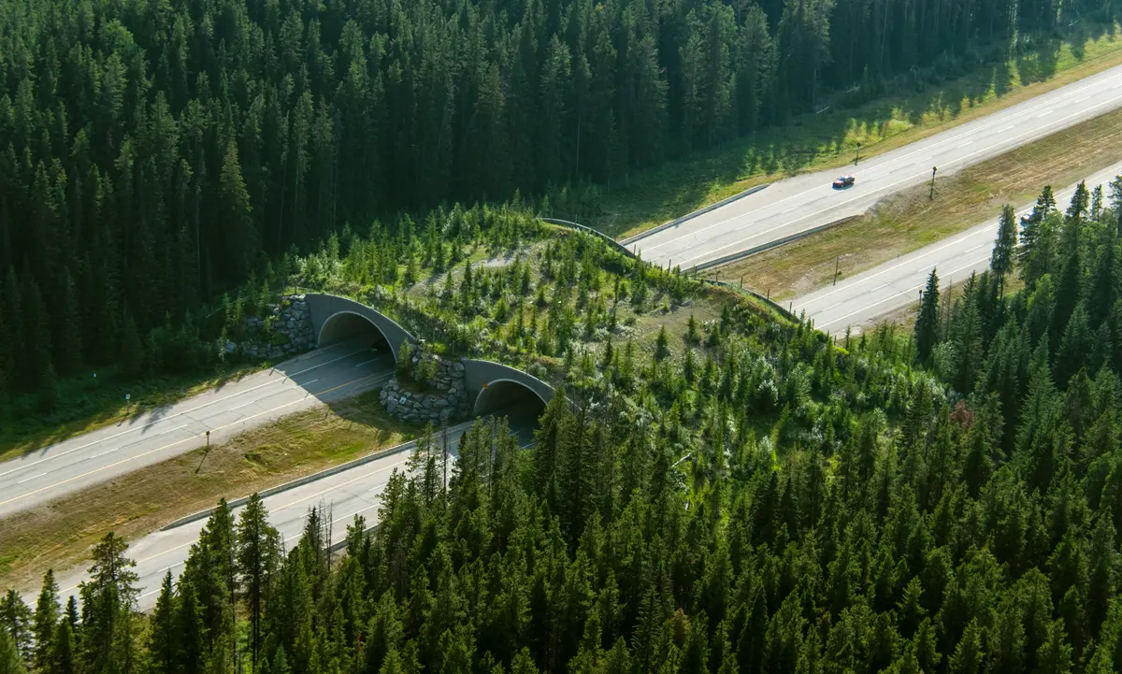

Slide 6
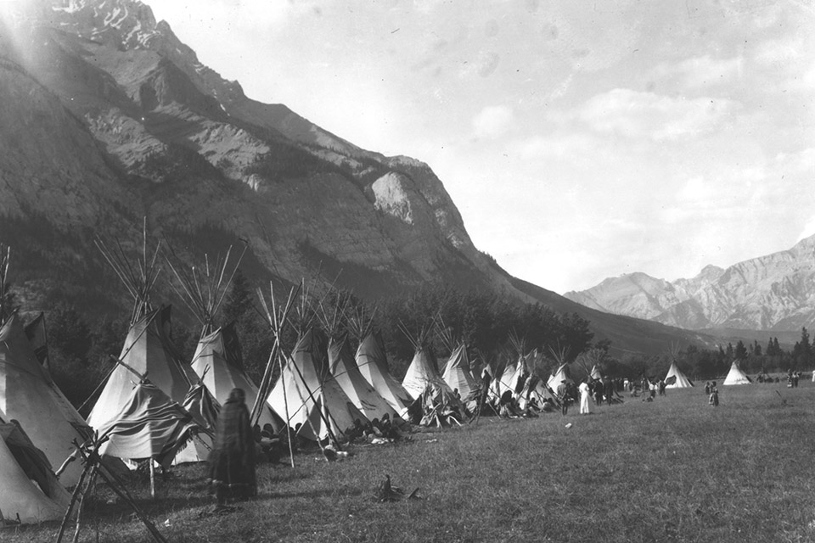

Slide 8
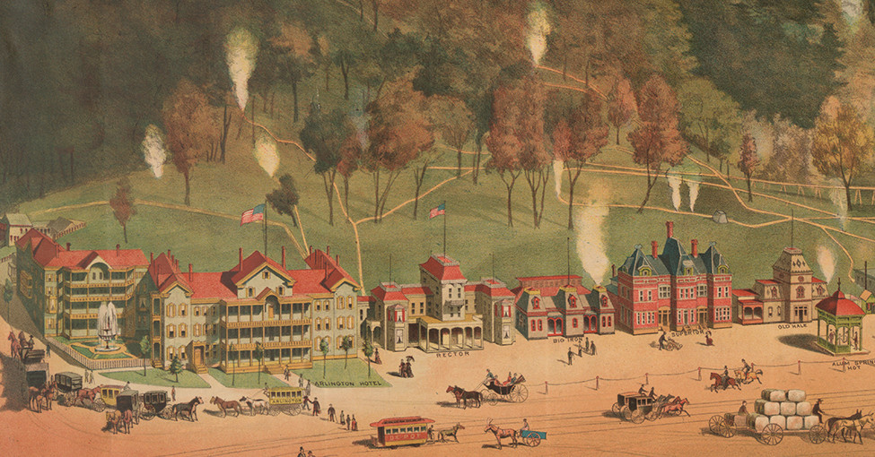

Slide 9
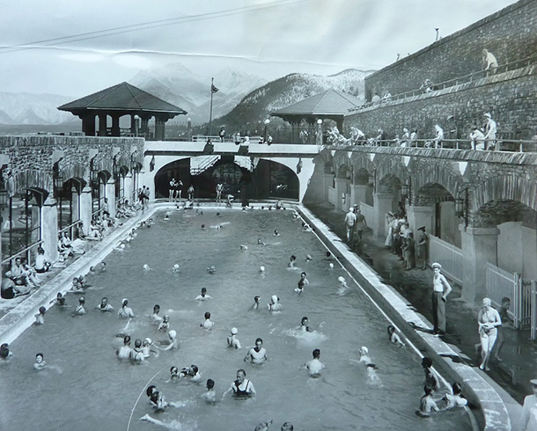

Slide 10
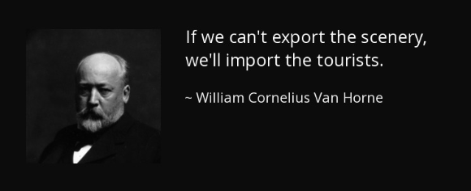

Slide 11
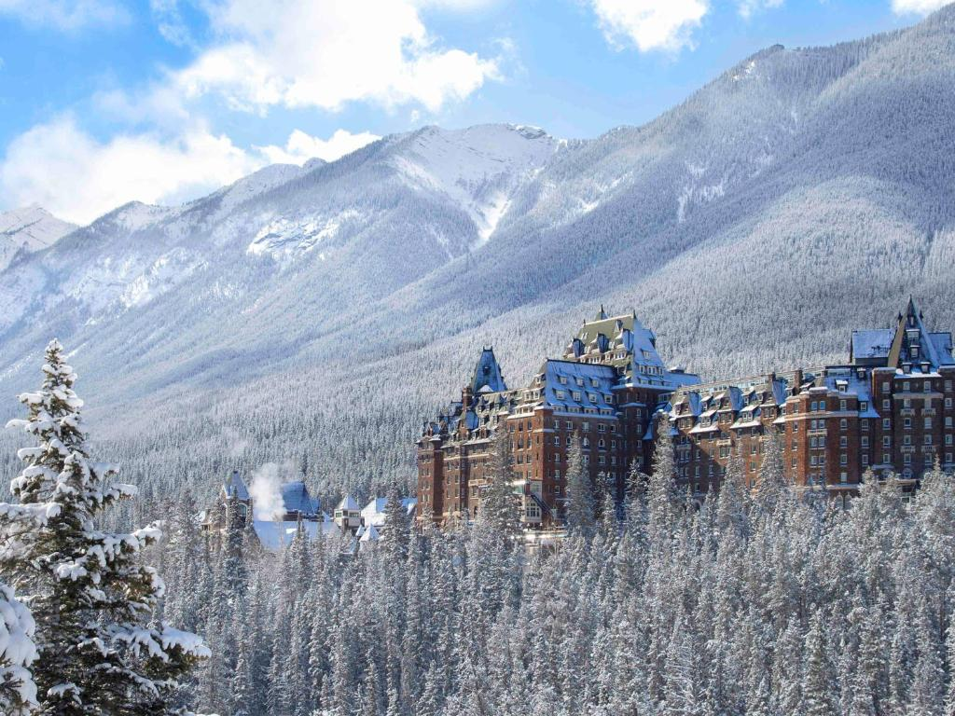

Slide 12
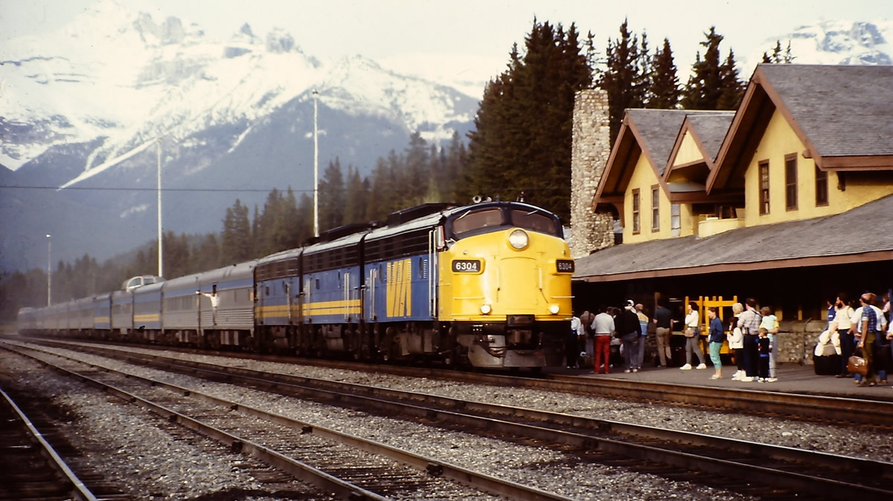

Slide 13
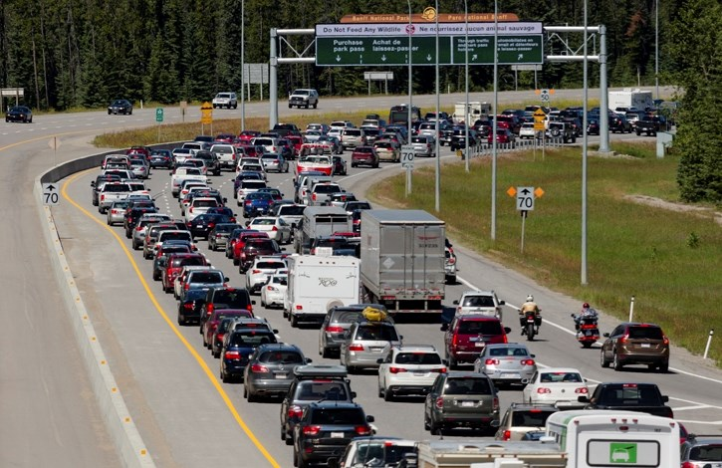

Slide 14
Calgary to Banff : 80 miles

Slide 18
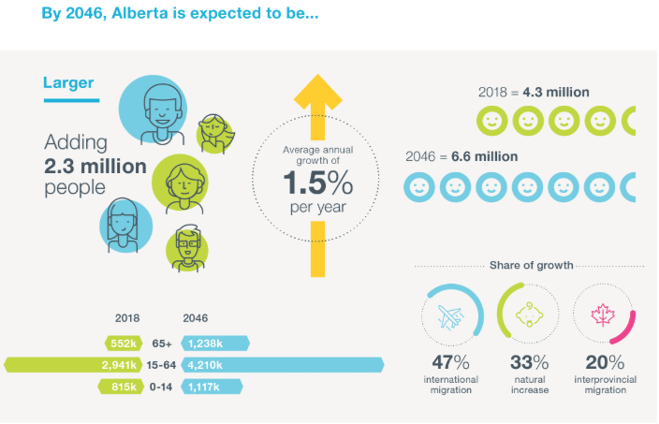

Slide 19
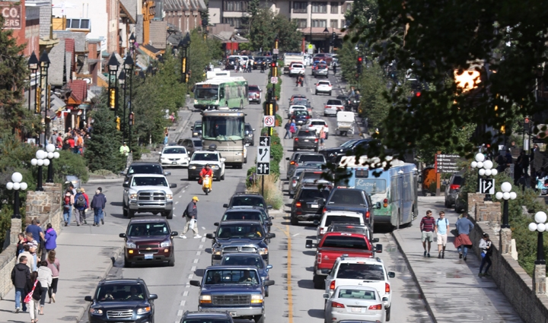

Slide 21
The Four Pillars
Regional mass transit to Calgary…….....
Intercept Parking at edge of Town……..
Local transit……………………………………….
Disincentives and Incentives…………….
Intercept

Slide 22
Regional Mass Transit

Slide 23
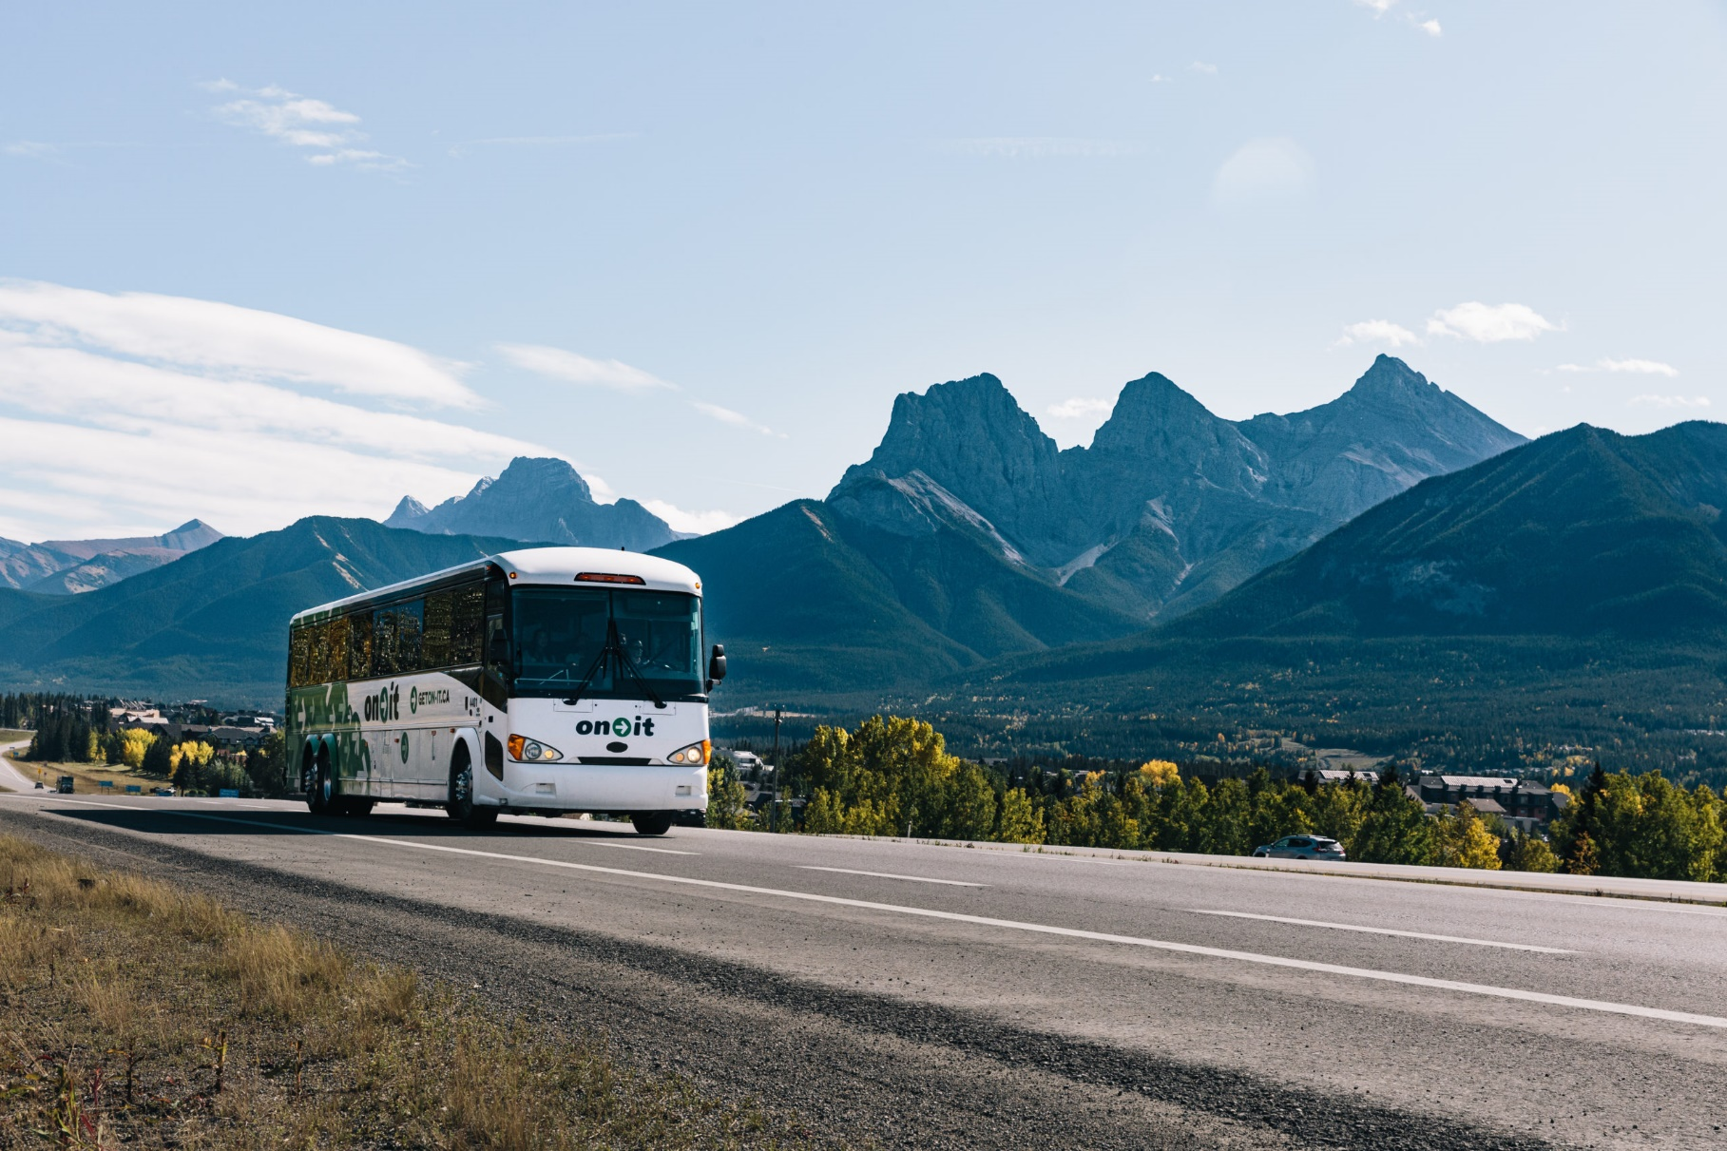
Regional Mass Transit

Slide 24
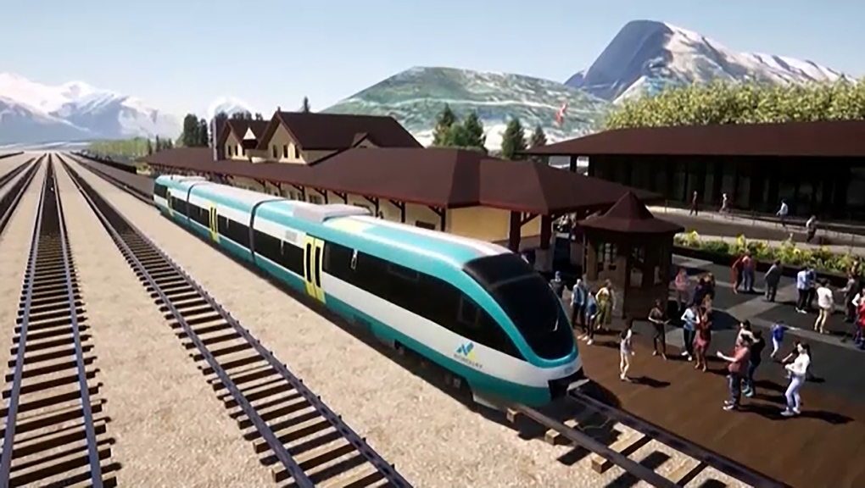
Regional Mass Transit

Slide 25
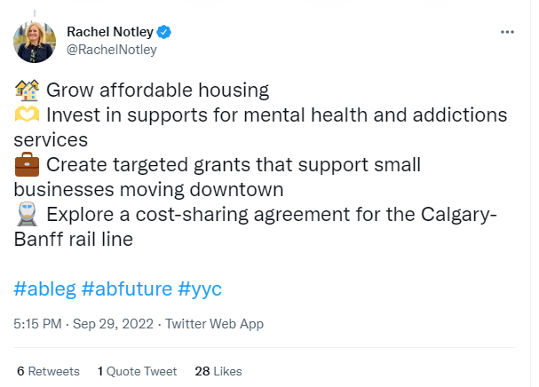
Regional Mass Transit

Slide 26
Regional Mass Transit
What we’re learning:
Starting small and scaling up can be helpful
Critical to have higher level’s of government on-board
Still huge opportunity for regional mode shift

Slide 27
Intercept Parking
Preventing / encouraging vehicles from entering the road system
Initial point of contact at entry to Town
Proximity that allows for walking and transit
Convenience that rivals the private vehicle

Slide 28
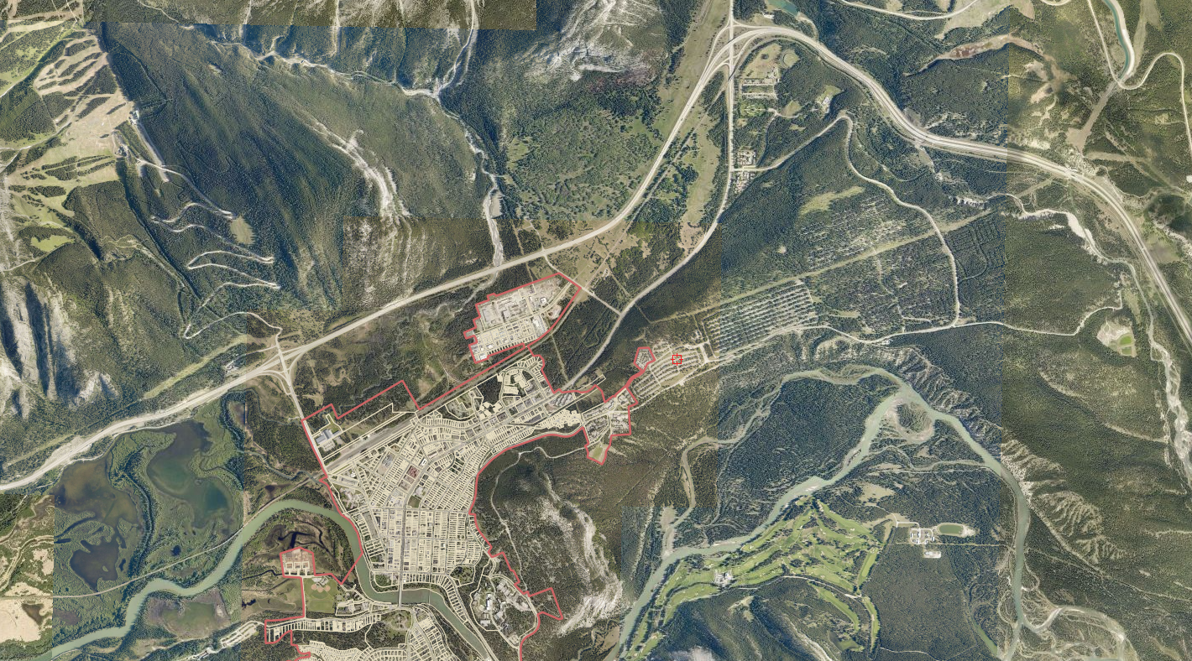
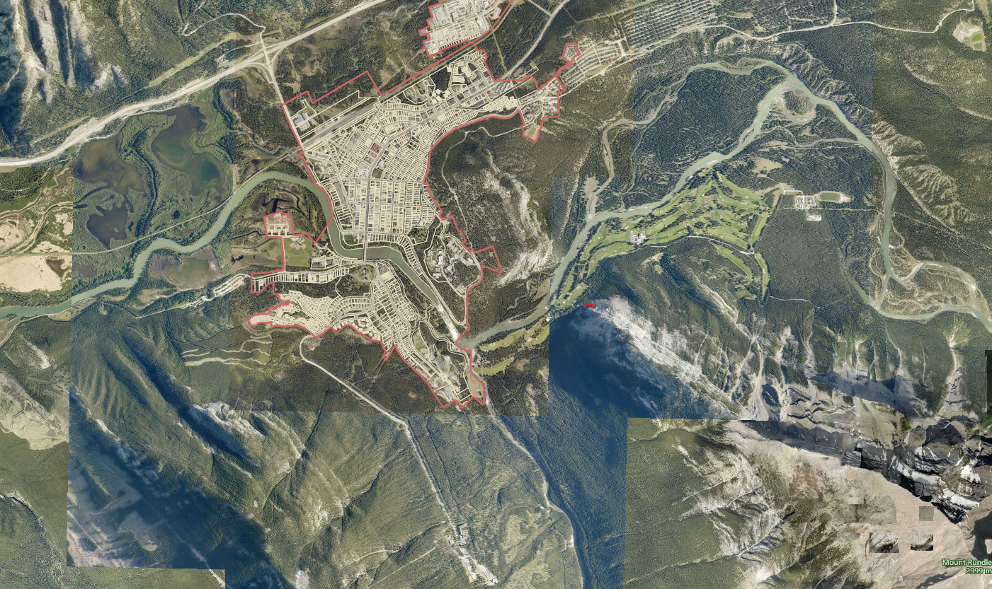
From Calgary
Intercept Parking
Entrance 1: Banff Avenue
Intercept Parking
Entrance 2: Mt Norquay
Downtown
Cave and Basin
Banff Springs Hotel
Sulphur Mtn. Gondola

Slide 29
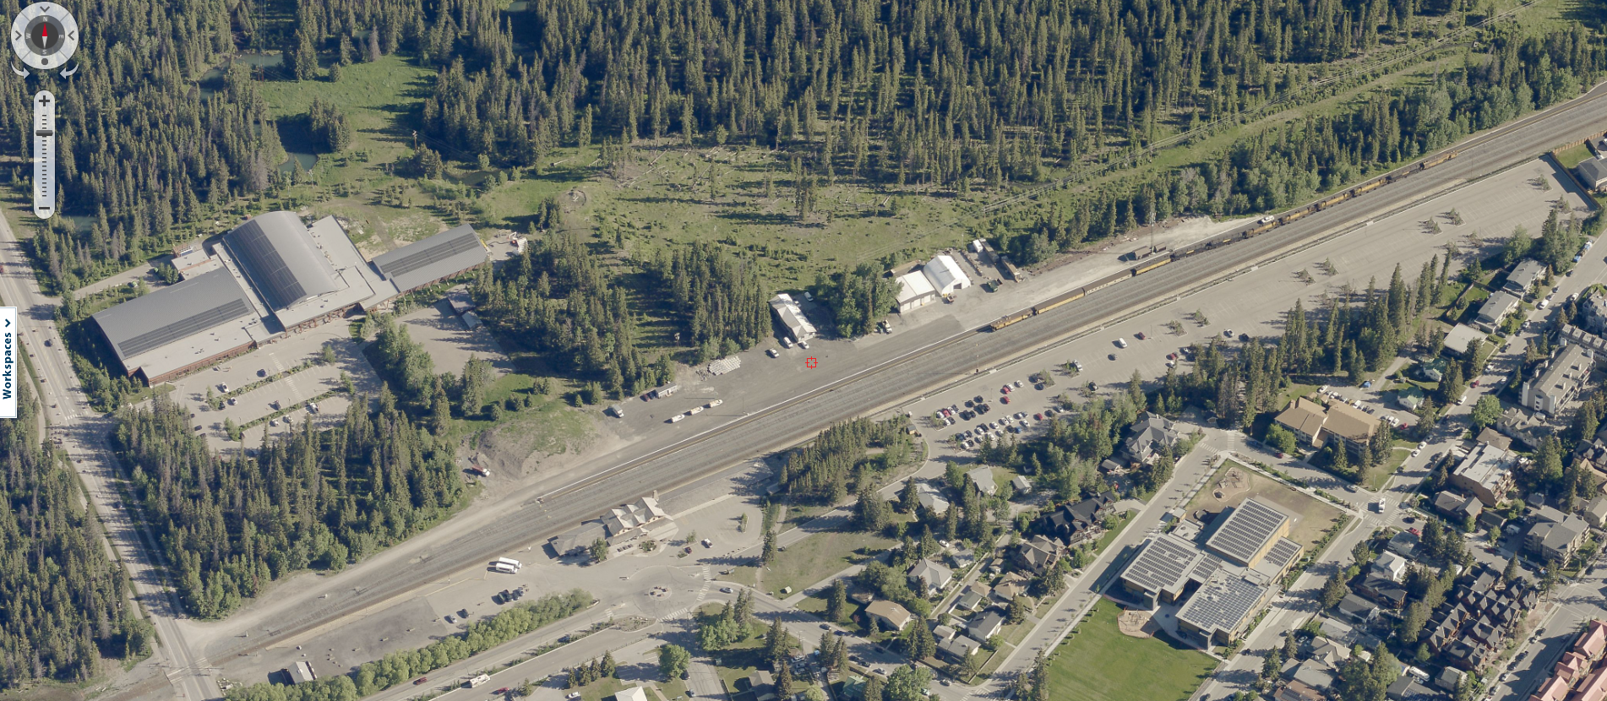
Intercept Parking

Slide 30
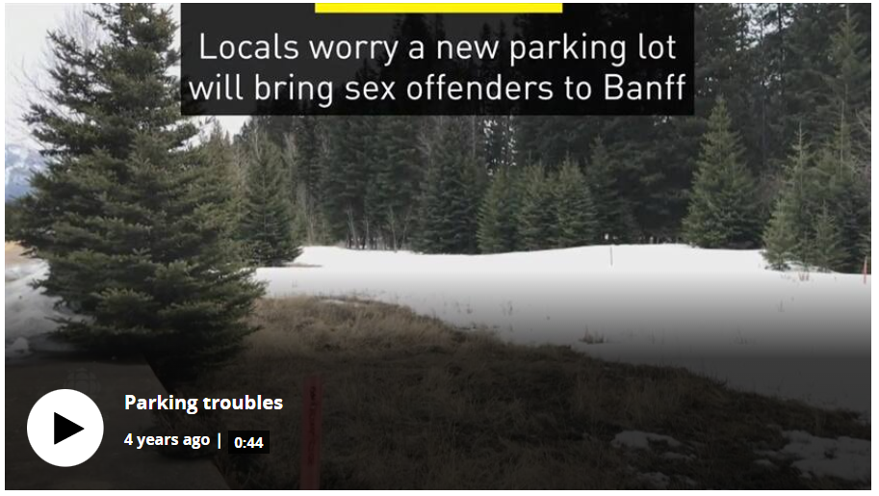
Intercept Parking

Slide 31
Intercept Parking
What we’re learning:
Intercept Parking works!
Visitors may value certainty over convenience
Pricing transportation can be a critical factor
Vulnerable populations need to be accounted for

Slide 32
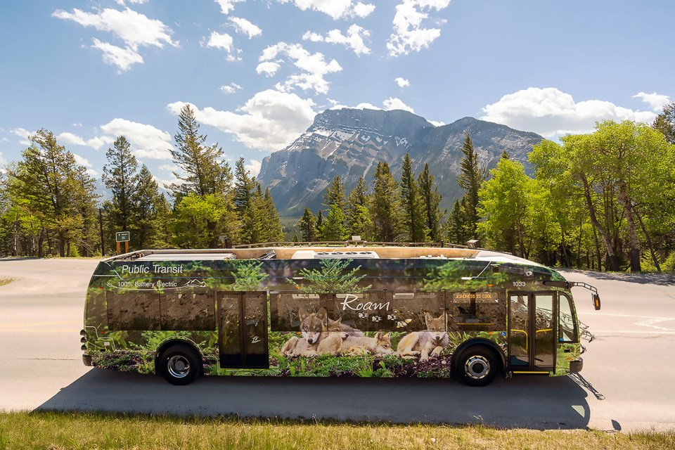
Local Transit

Slide 33
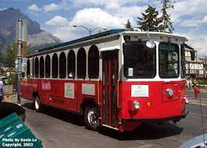
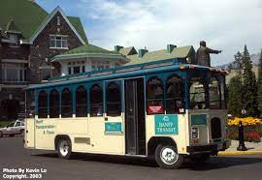
Local Transit

Slide 34
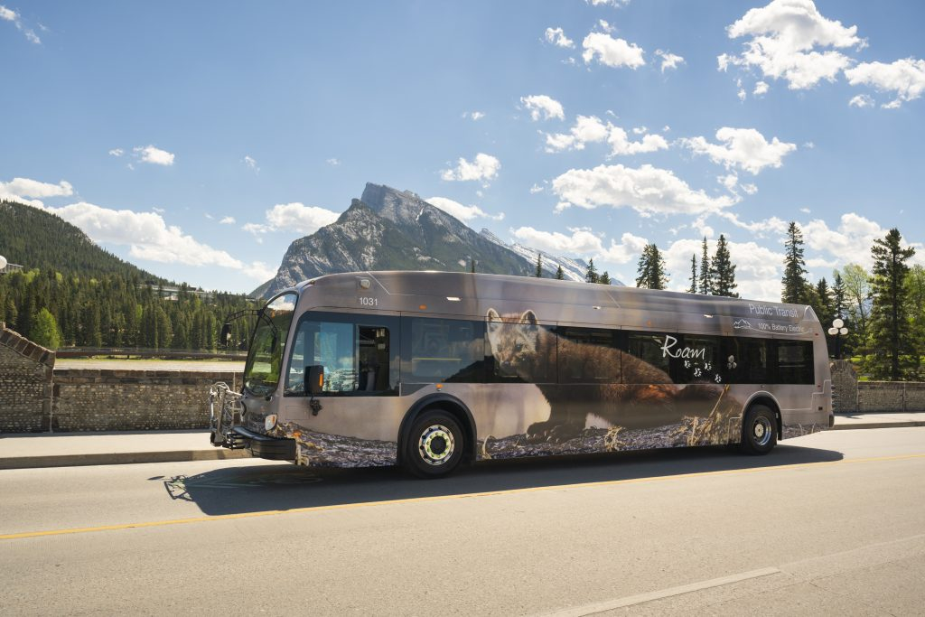
Local Transit

Slide 35
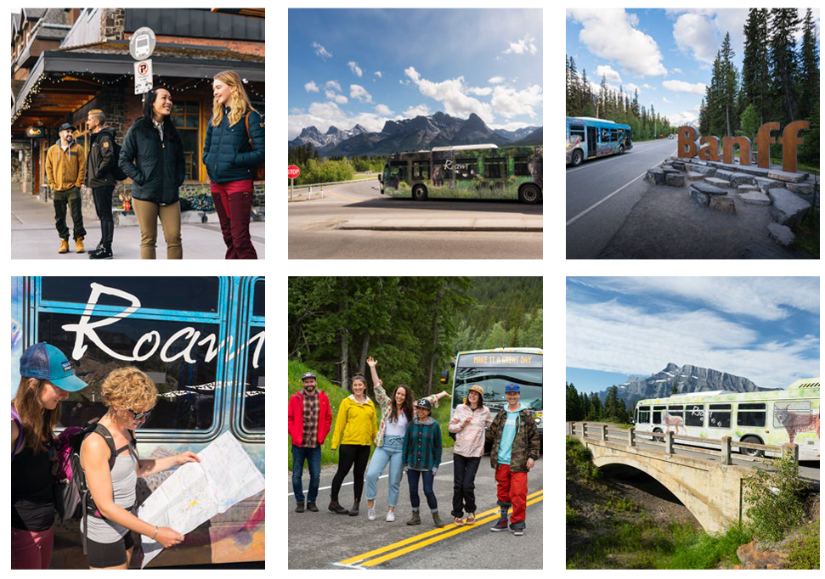
Local Transit

Slide 36
Local Transit
Hotel partnerships
School partnerships
Fare-free transit for residents
Regional transit to Calgary
Bus marketing celebrating local photographers

Slide 37
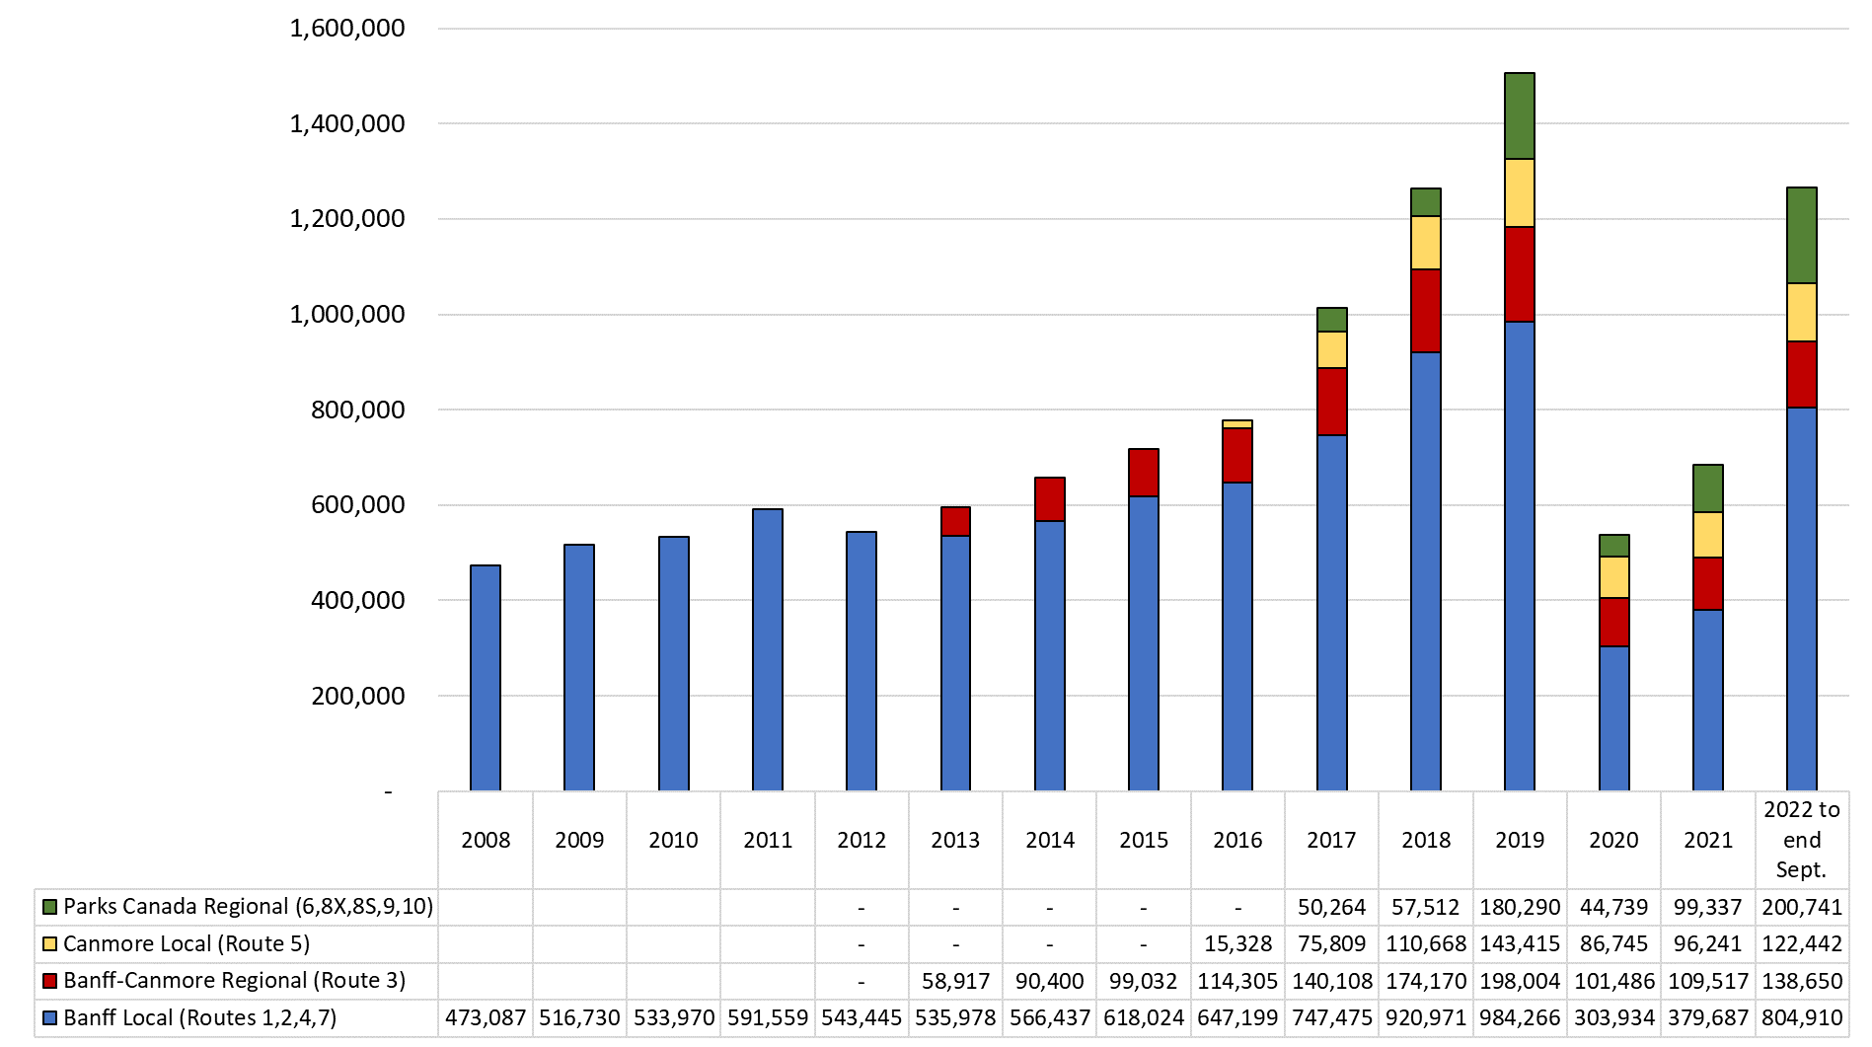
Local Transit

Slide 38
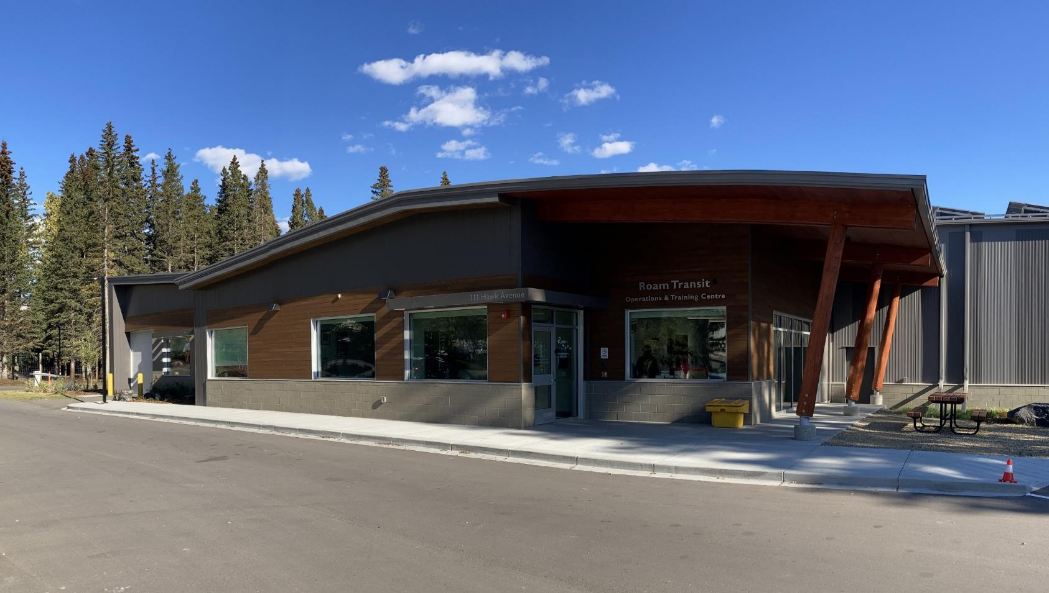
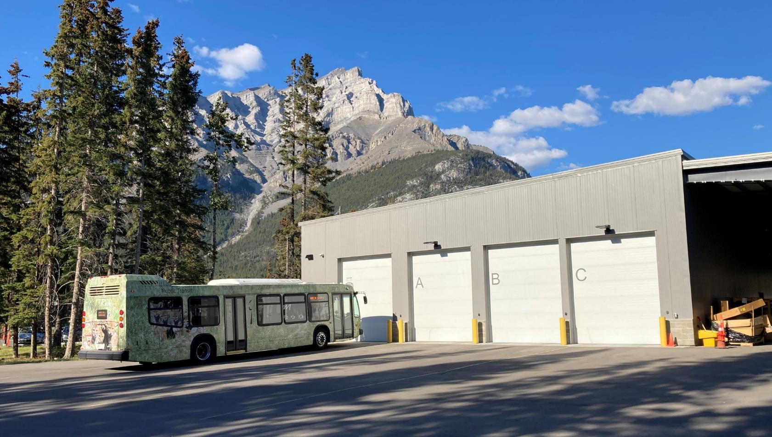
Local Transit

Slide 39
Local Transit
What we’re learning:
Stronger together; Working with partners was of exponential benefit
Being a case study for innovation helps
Providing community connections increases chances of success

Slide 40
Disincentives and Incentives
Paid Parking / Resident Parking
Bear Street pedestrian improvements
Pedestrian bridge infrastructure
Temporary pedestrian zone
Wayfinding
Smart Parking
E-bikes
Free resident transit

Slide 41
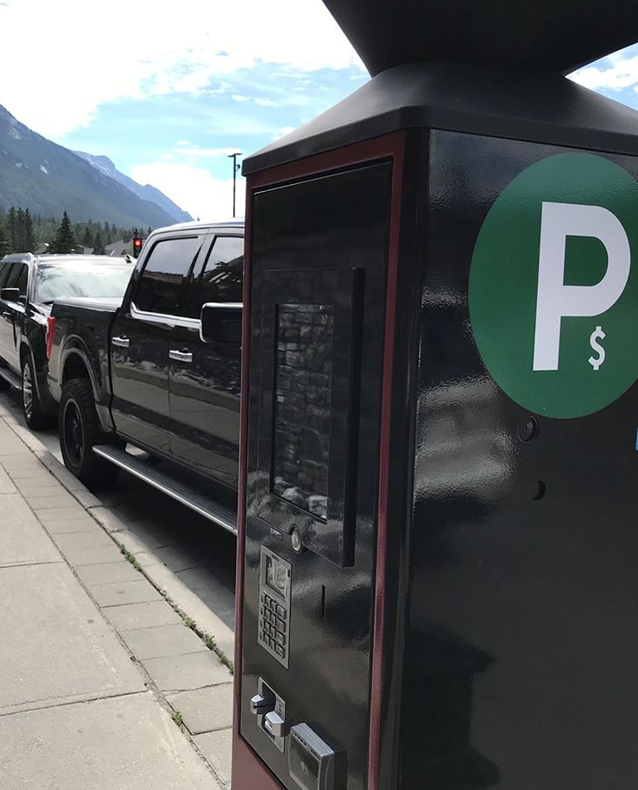
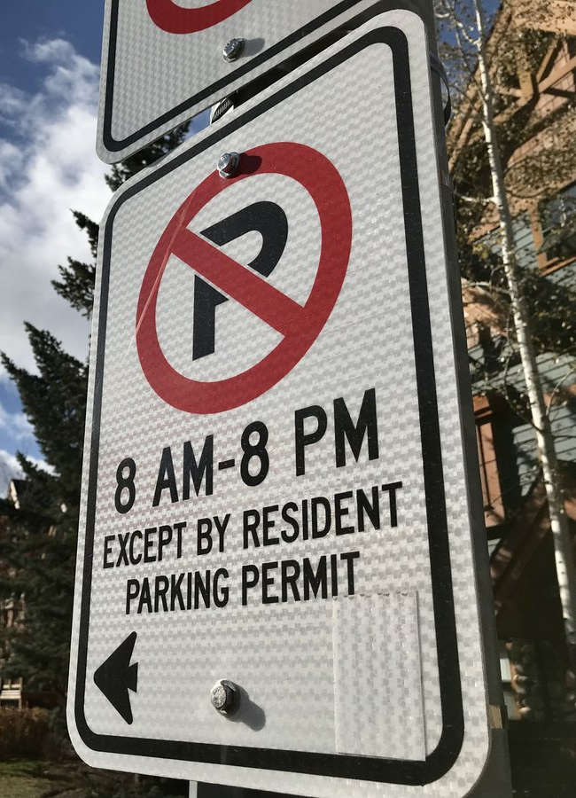
Disincentives and Incentives

Slide 42
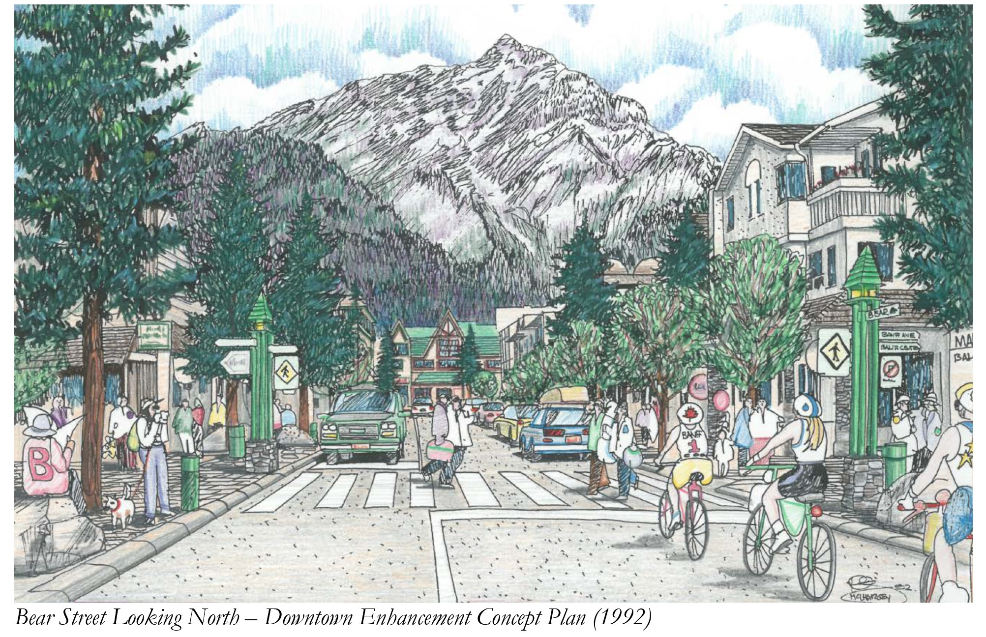
Disincentives and Incentives

Slide 43
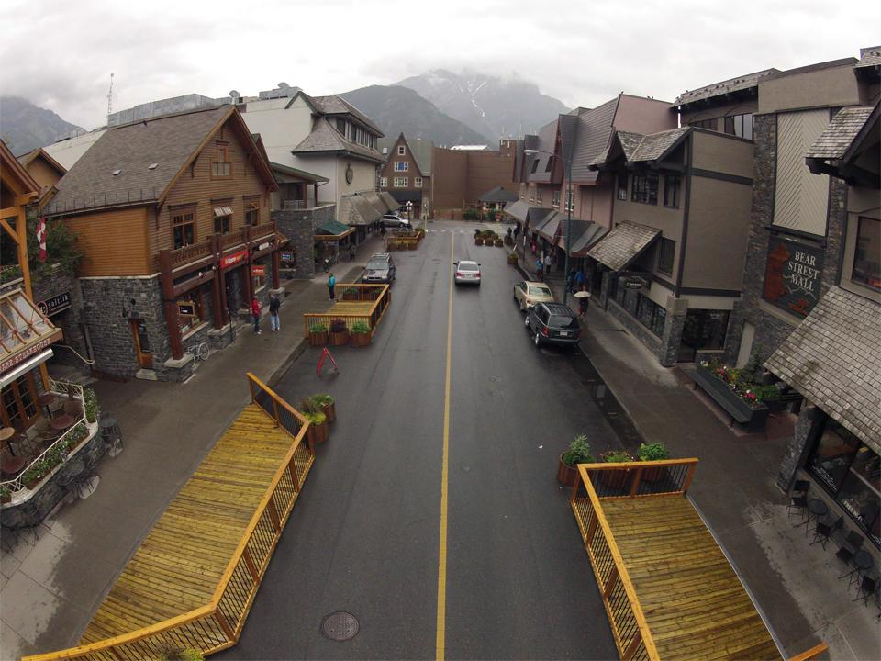
Disincentives and Incentives

Slide 44
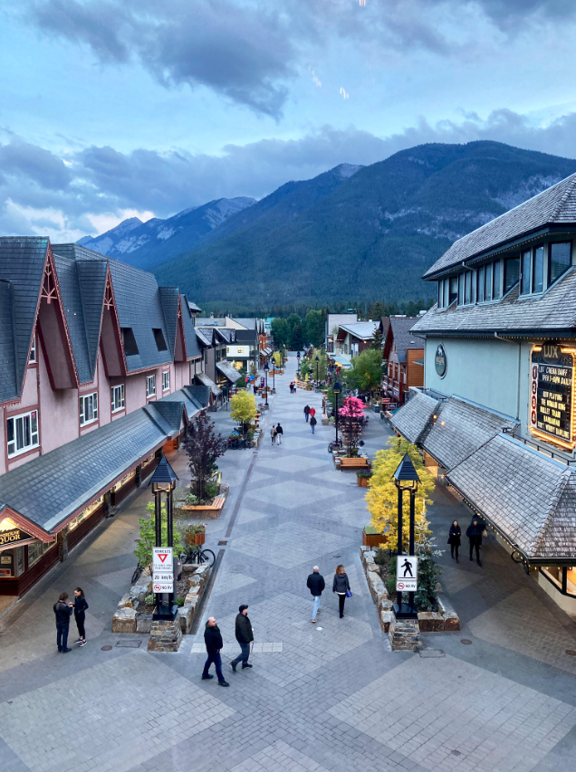
Disincentives and Incentives

Slide 45
Disincentives and Incentives

Slide 46
Disincentives and Incentives

Slide 47
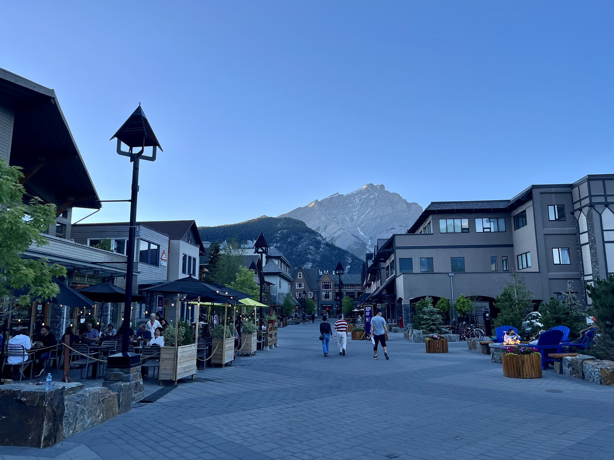
Disincentives and Incentives

Slide 48
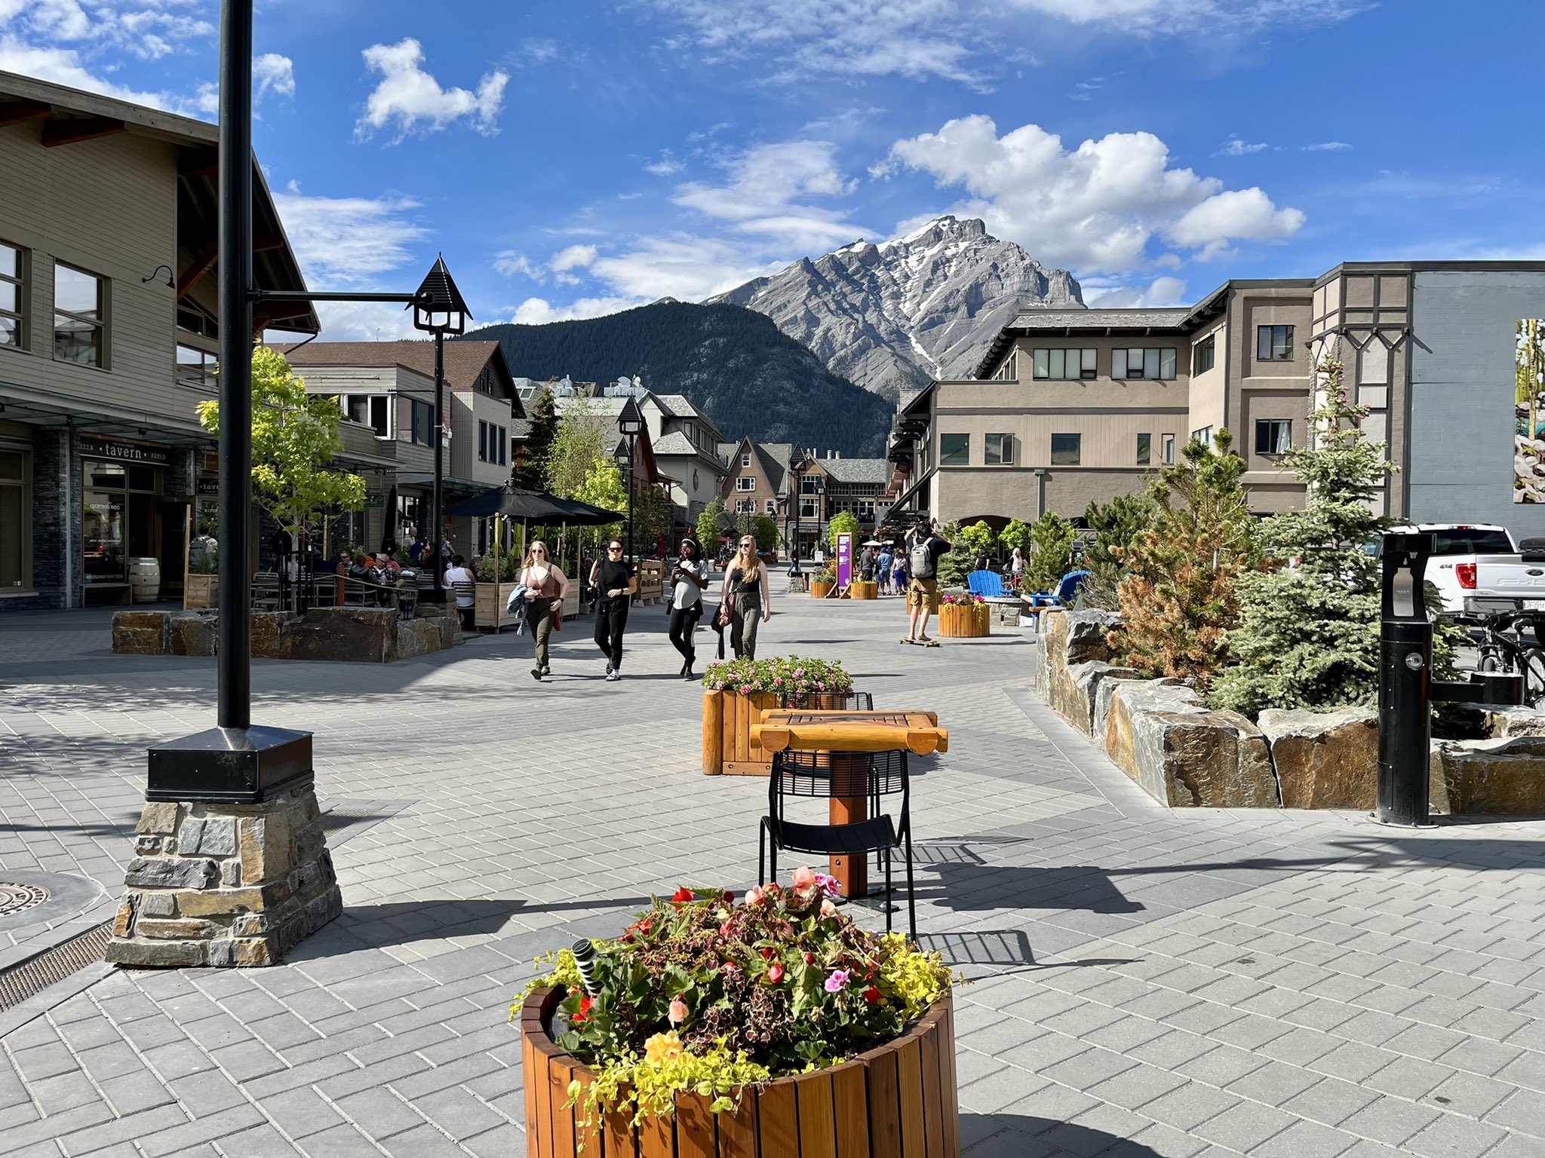
Disincentives and Incentives

Slide 49
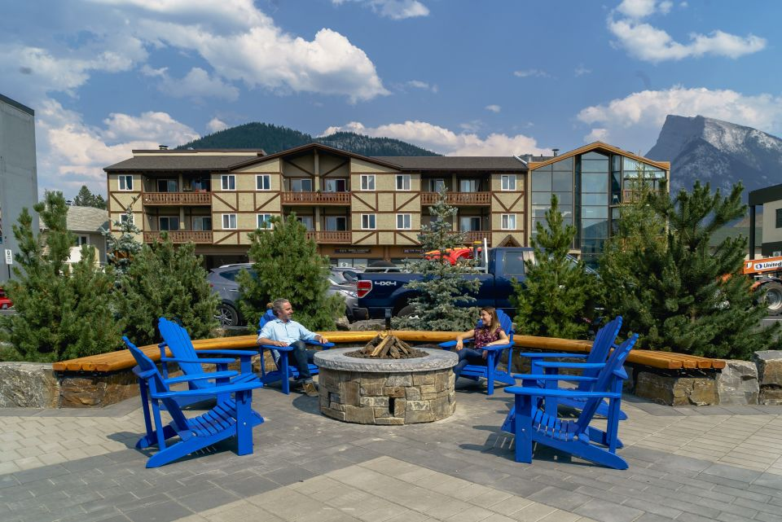
Disincentives and Incentives

Slide 50
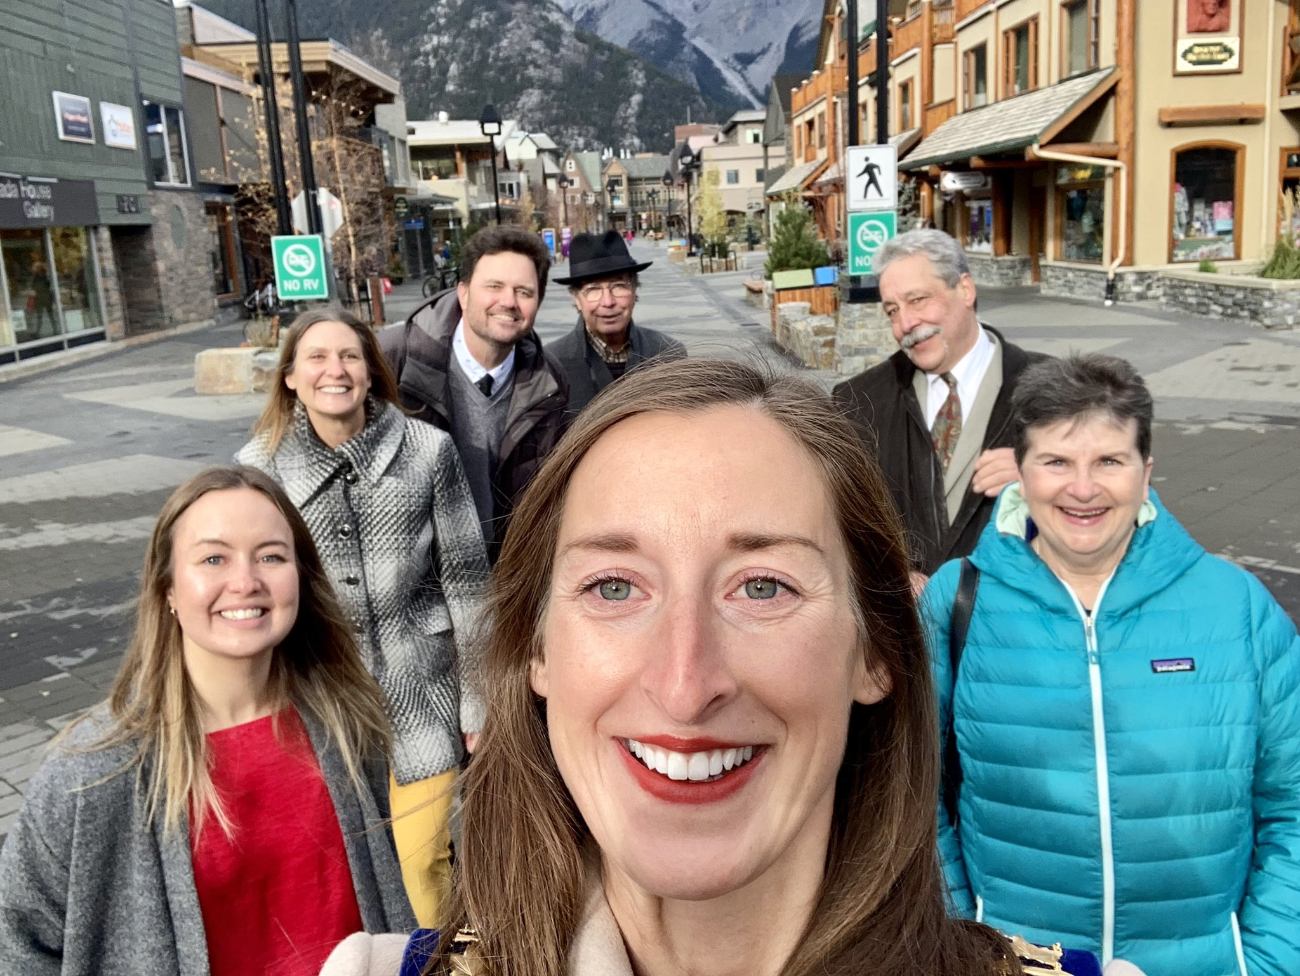
Disincentives and Incentives

Slide 51
Disincentives and Incentives

Slide 52
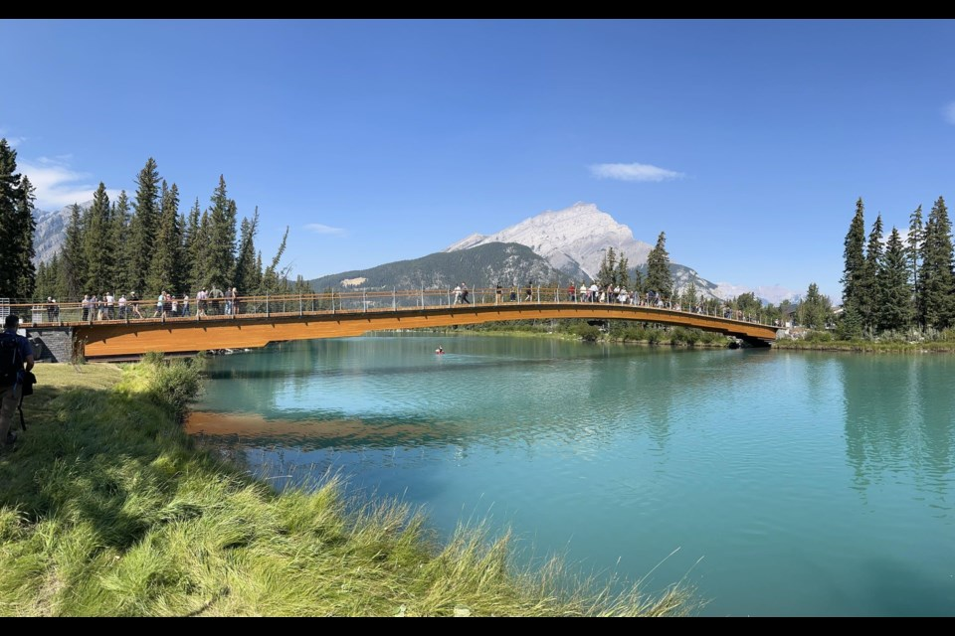
Disincentives and Incentives

Slide 53
Disincentives and Incentives

Slide 54
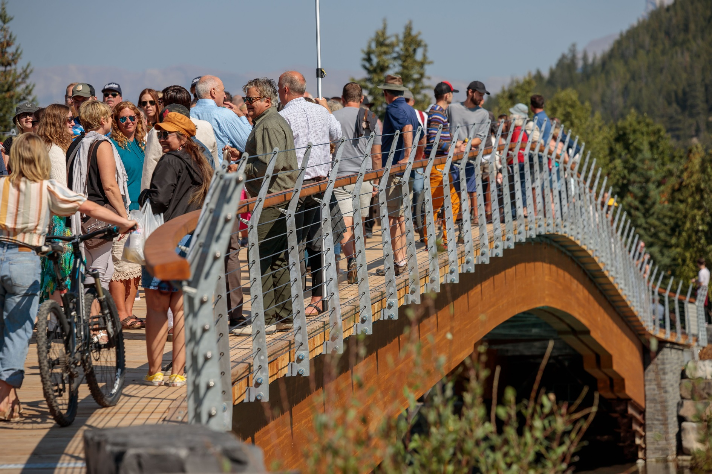
Disincentives and Incentives

Slide 55
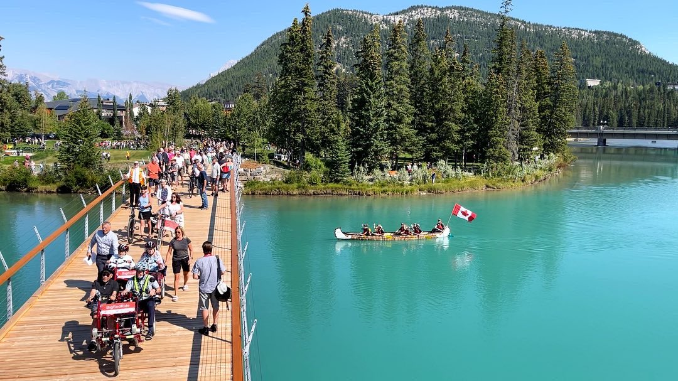
Disincentives and Incentives

Slide 56
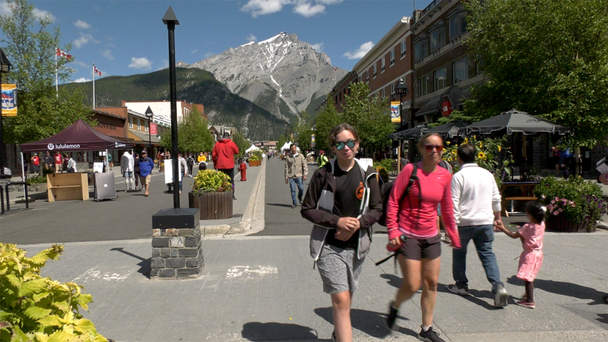
Disincentives and Incentives

Slide 57
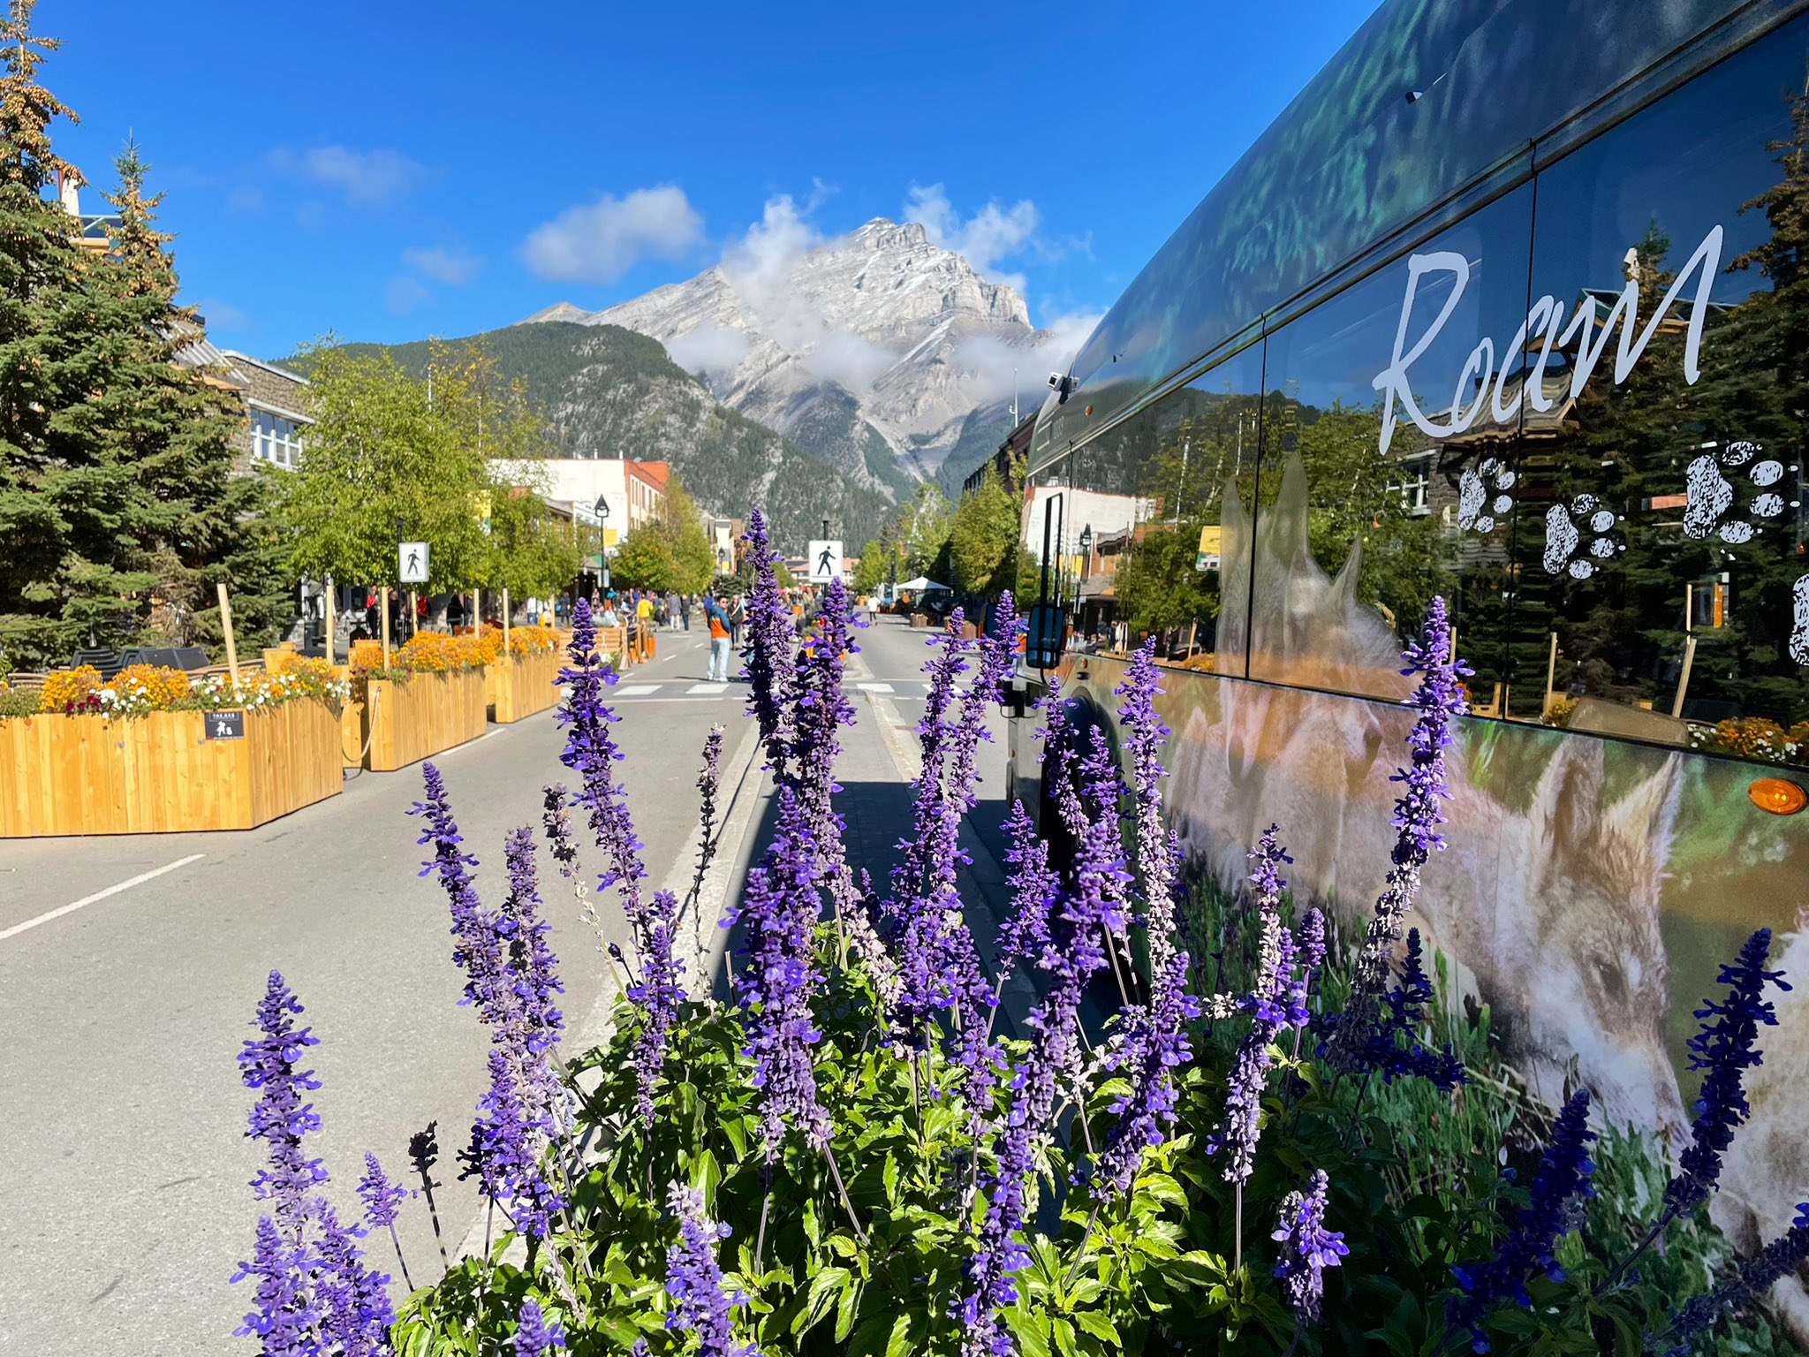
Disincentives and Incentives

Slide 58
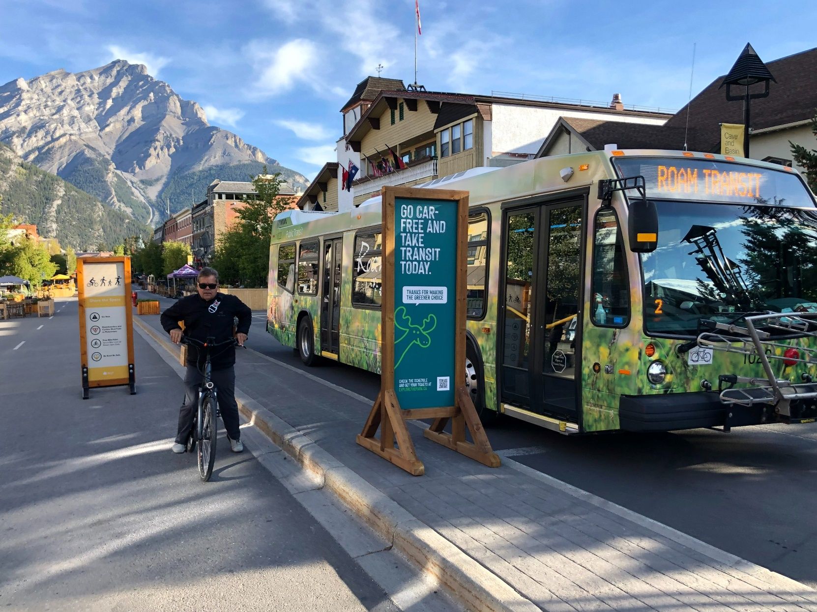
Disincentives and Incentives

Slide 59
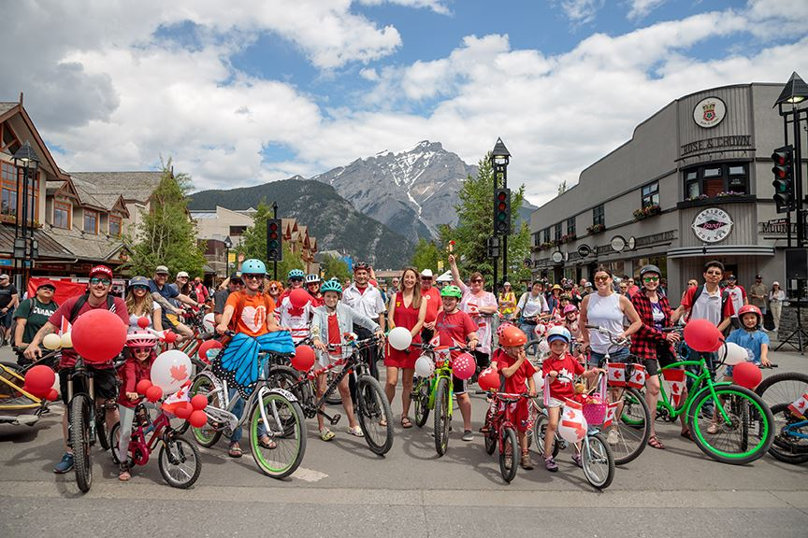
Disincentives and Incentives

Slide 60
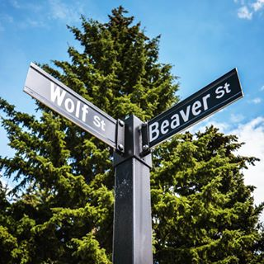
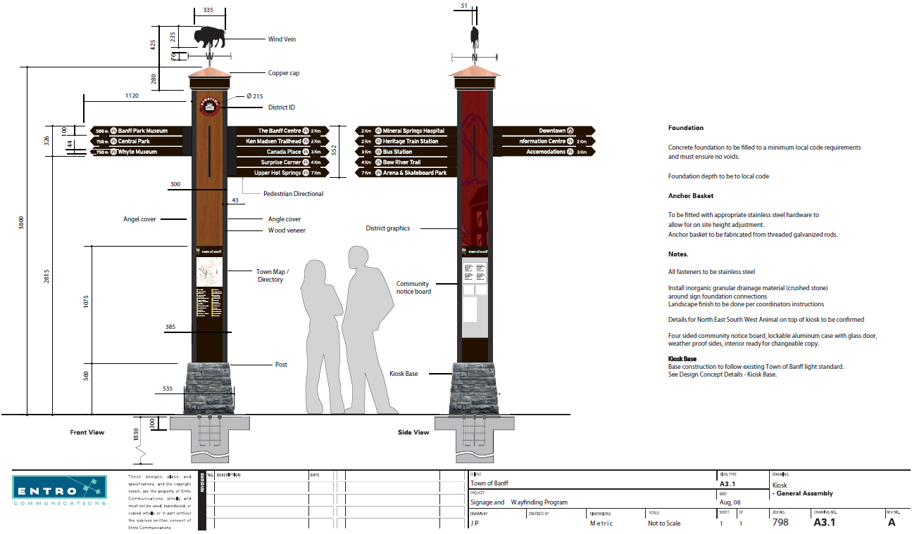
Disincentives and Incentives

Slide 61
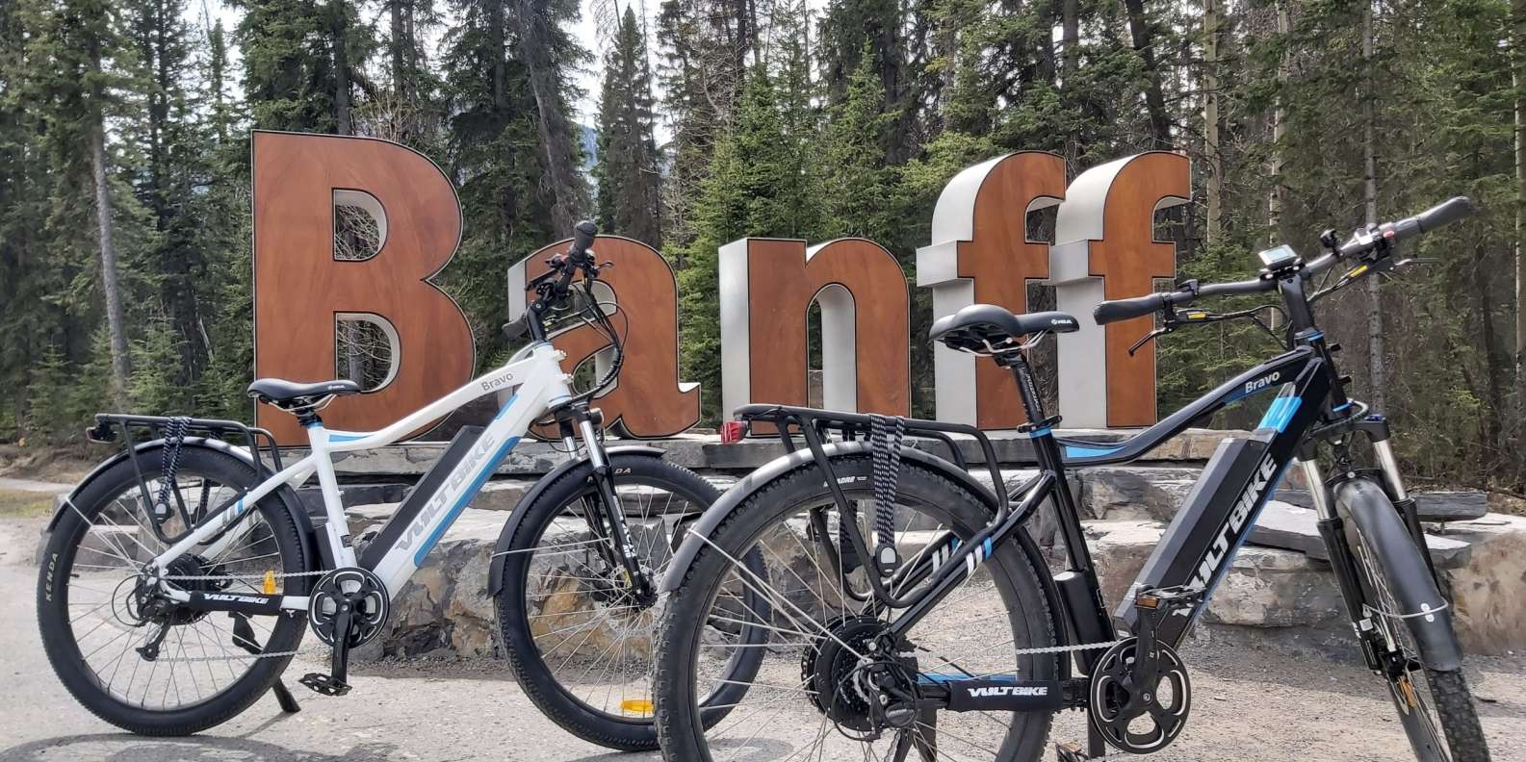
Disincentives and Incentives

Slide 62
Disincentives and Incentives

Slide 63
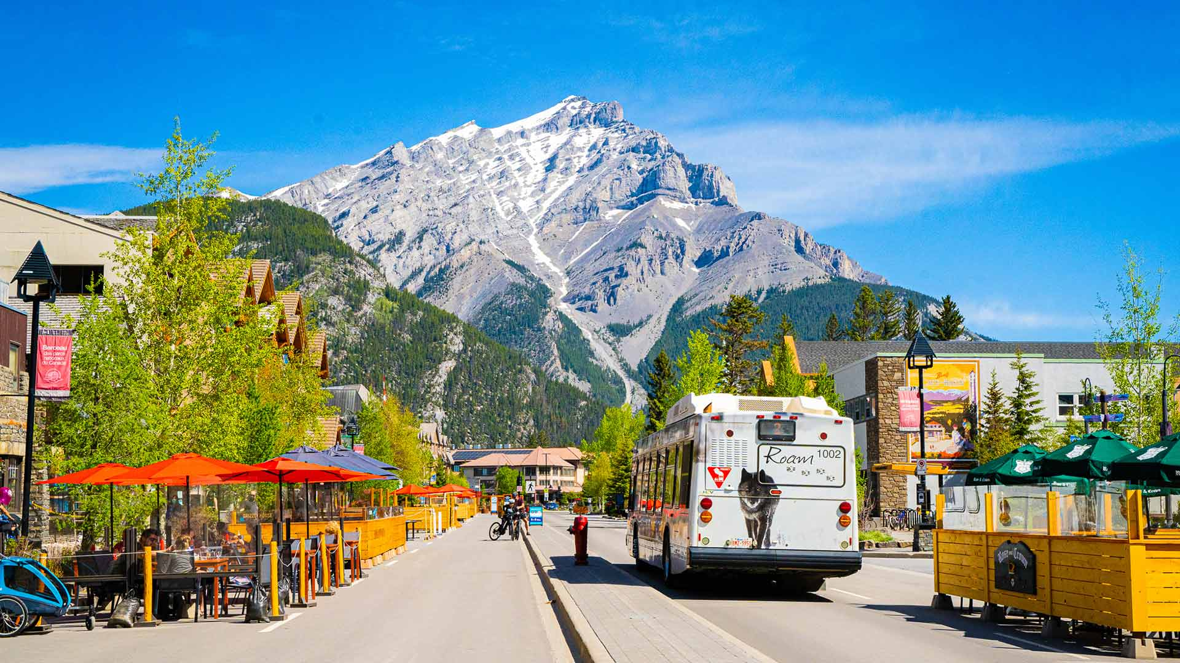
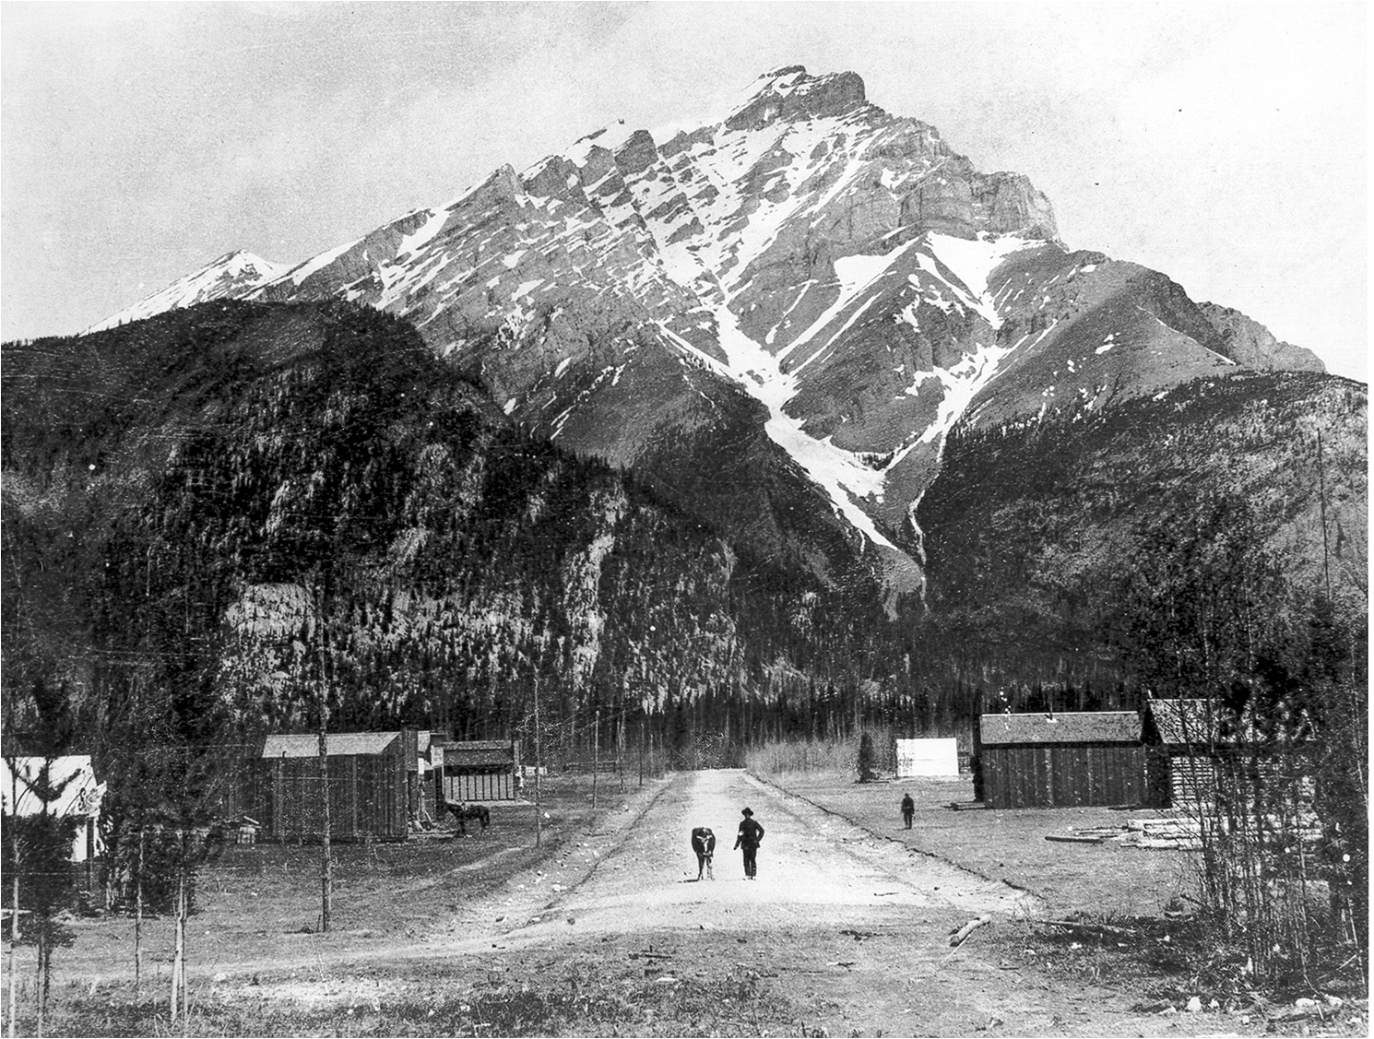
Summary
Summary

Slide 64
Thank You
National Parks are maintained for all the people – for the ill that they may be restored; for the well that they may be fortified and inspired by the sunshine, the fresh air, the beauty, and all the other healing, ennobling agencies of Nature. They exist in order that every citizen of Canada may satisfy his craving for Nature and Nature’s Beauty; that he may absorb the poise and restfulness of the forests; that he may fill his soul with the brilliance of the wild flowers and the sublimity of the mountain peaks; that he may develop the buoyancy, the joy, and the activity that he sees in the wild animals; that he may stock his brain and mind with great thoughts, noble ideals; that he be made better, be healthier, and happier.

